Slide 1




Chapter 16: Data Preparation for Analysis

Slide 2
Learning Objectives
Explain the purpose of the editing process
Define what coding is
Describe the kinds of information contained in a codebook
Describe common methods for cleaning the data file
Discuss options for dealing with missing data in analyses

Slide 3
Primary Tasks in the Editing Process
Editing: the inspection and correction of the data received form each element of the sample (or census)
Convert all responses to consistent units
Assess degree of nonresponse
Where possible check for consistency across responses
Look for evidence that the respondent wasn’t really thinking about his o her answers
Verify that branching questions were followed correctly
Add any needed codes

Slide 4
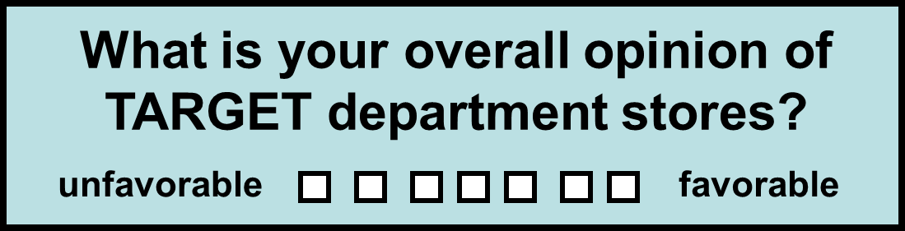
Coding Closed-Ended Items
Coding: The process of transforming raw data into symbols (usually numbers)
(Typical coding: 1 2 3 4 5 6 7 )

Slide 5
Coding Closed-Ended Items
How did you learn about Brown Furniture Company? (check all that apply)
newspaper advertising
radio advertising
billboard advertising
recommended by others
drove by store
other: _______________
TYPICAL CODING:
6 different variables
(1 if checked; 0 if not)
(1 if checked; 0 if not)
(1 if checked; 0 if not)
(1 if checked; 0 if not)
(1 if checked; 0 if not)
(1 if checked; 0 if not)

Slide 6
Coding Closed-Ended Items
Factual open-ended items seeking concrete responses are relatively easy to code
Numeric answers are typically recorded as given by the respondent, while other types of responses are given a specific ode number
Example
(1): In what year were you born? (code year)
(2): how many times have you eaten at Streeter’s Grill int eh last month? (code number)
(3) Name the first 3 coffee shops located in Tampa that come to mind (code as 3 separate variables; assign numbers to represent each coffee shop mentioned)

Slide 7
Coding Closed-Ended Items
Exploratory open-ended items seeking less structured responses are much more difficult to code
Example:
In your own words, give us 2 or 3 reasons why you prefer to leave the state after graduation

Slide 8
Process for Coding Exploratory Open-Ended Questions
Identify usable responses
Develop categories for responses
Sort responses into categories, using multiple coders; compare results
Assess the degree of agreement between coders

Slide 9
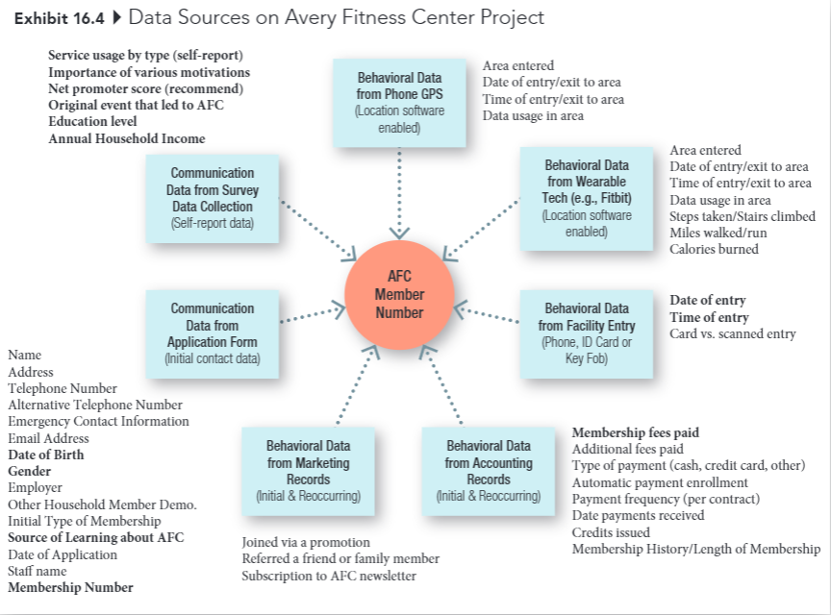
Avery Fitness Center Project

Slide 10
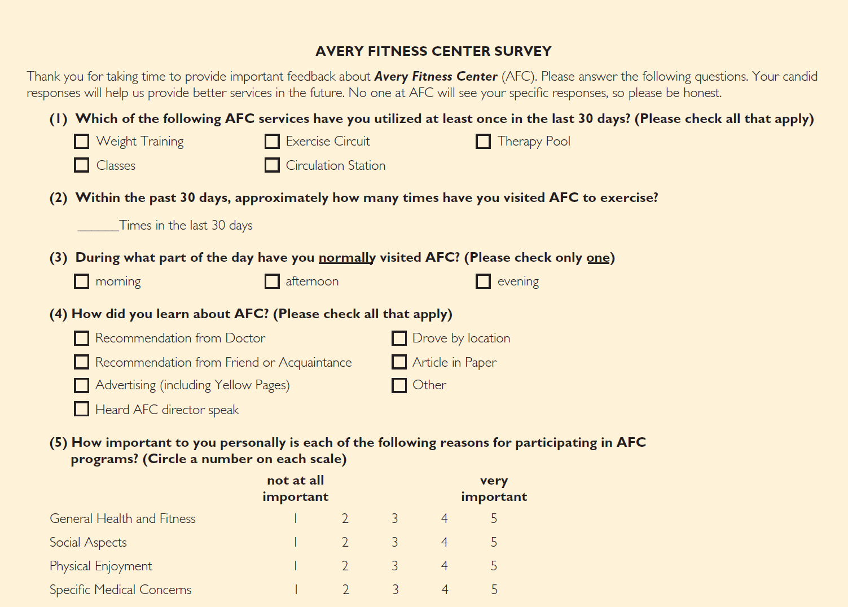
Avery Fitness Center Survey

Slide 11
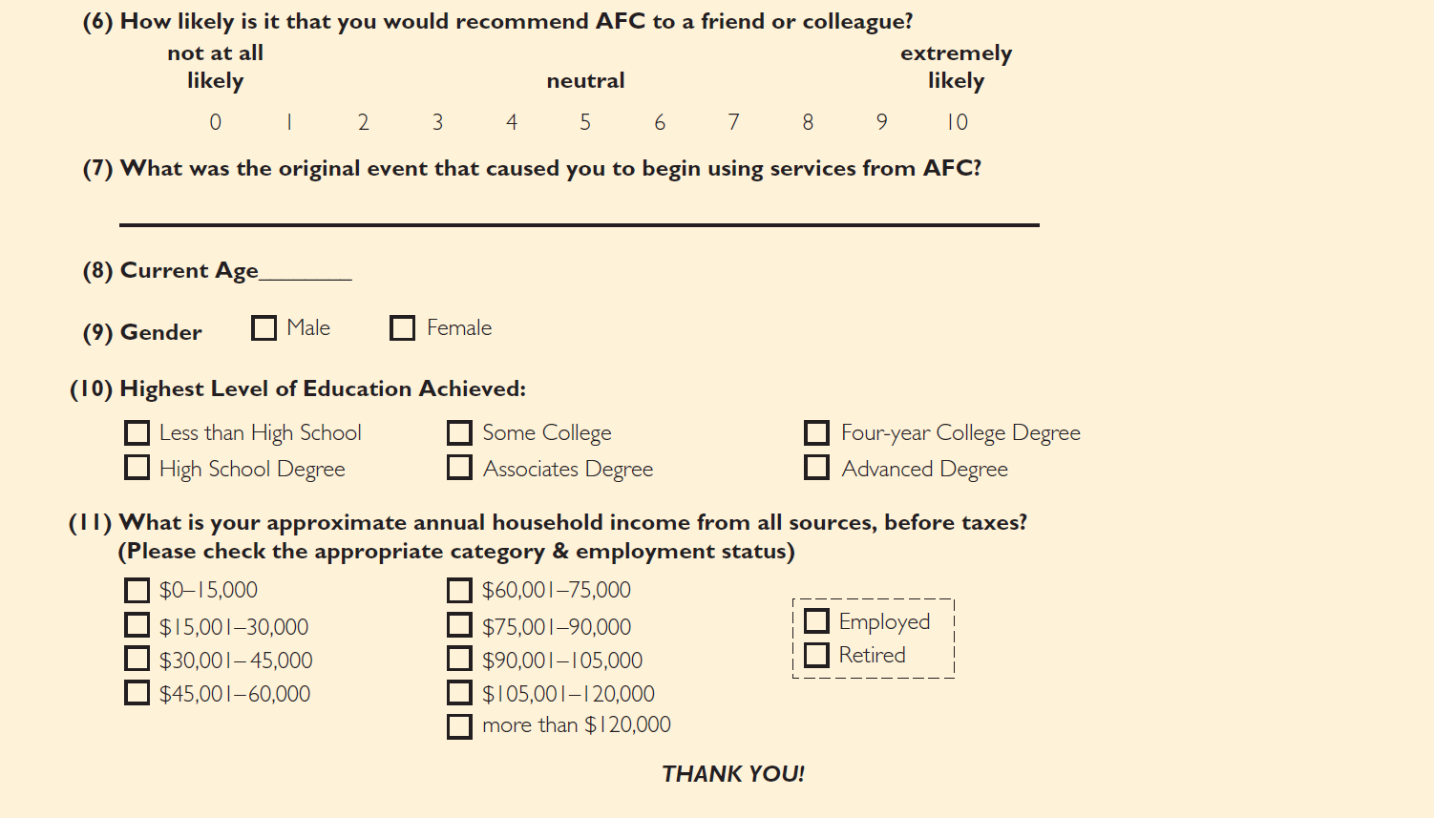
Avery Fitness Center Survey (cont.)

Slide 12
Developing a Codebook
Codebook: A document that contains explicit directions about how data from data collection forms are coded in the data file

Slide 13
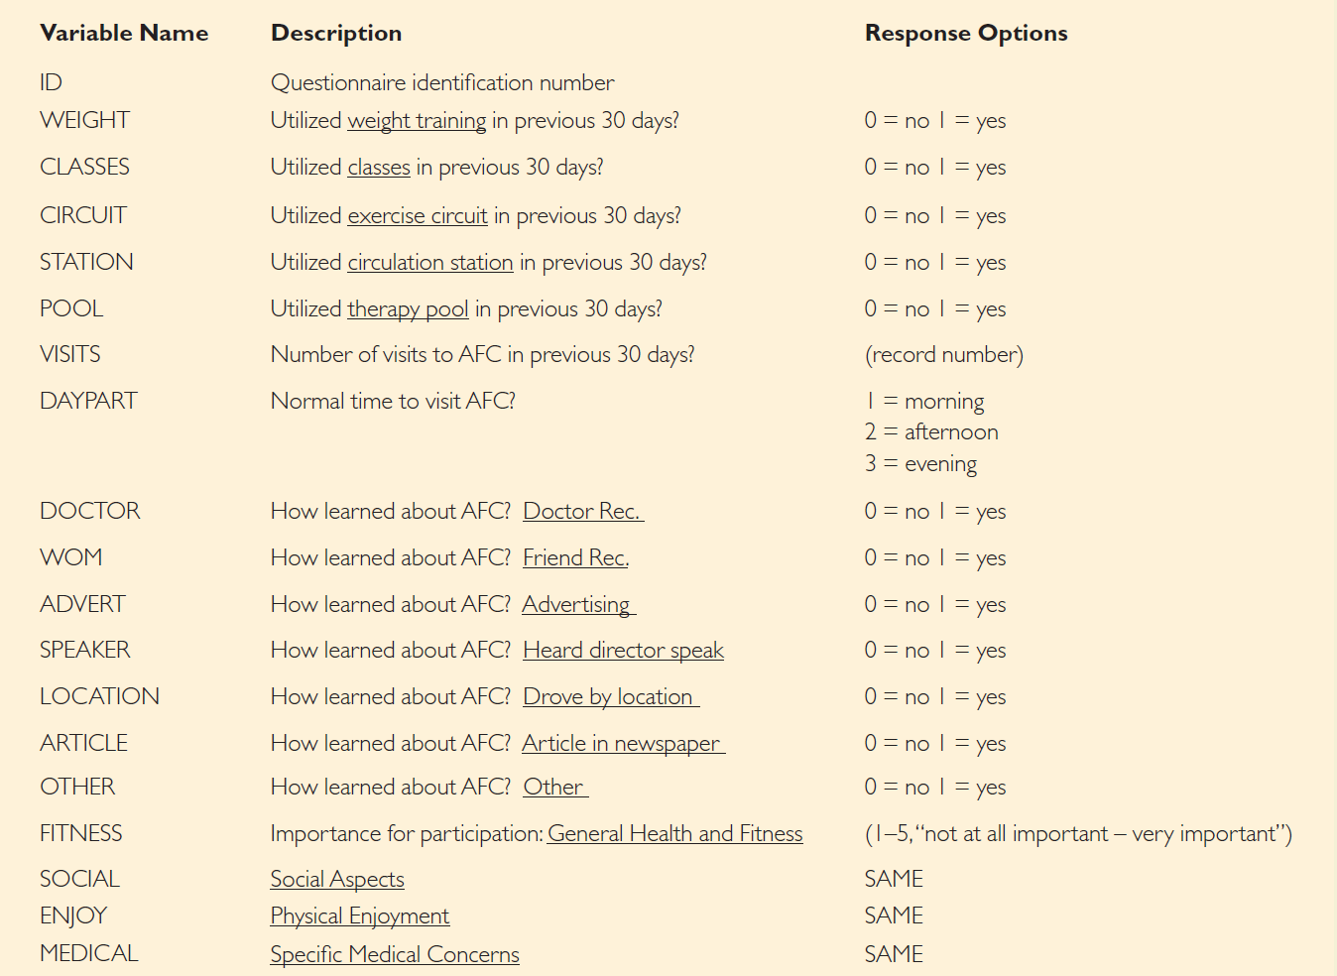
Codebook Example

Slide 14
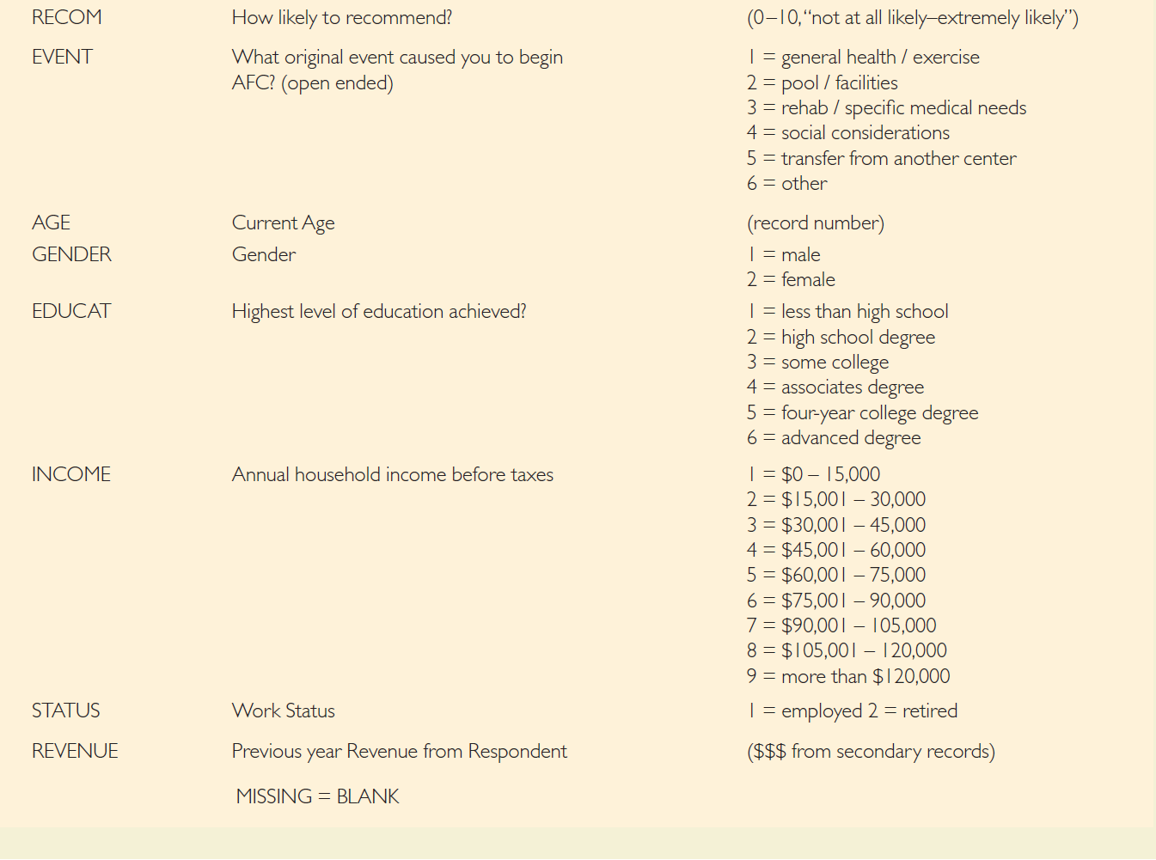
Codebook Example (cont.)

Slide 15
Cleaning the Data
Blunder: An error that arises during editing, coding, or data entry
Blunders are usually due to researchers carelessness
How to identify blunders:
Run frequency analysis on all variables
Check a sample of questionnaires against the data file
Double-entry of data (preferred)

Slide 16
Handling Missing Data
Item Nonresponse: A source of error that arises when a respondent agrees to an interview but refuses, or is unable, to answer specific questions
If a particular case has a significant amount of item nonresponse, it should probably be eliminated during the editing process

Slide 17
Alternative Strategies for Handling Missing Data
Eliminate the case with the missing item(s) from all further analyses
Eliminate the case with the missing item in analyses using the variable
Substitute values for the missing items
Contact the respondent again

